Slide 1

Department of Computer Science and Engineering(Data Science)
Sri Venkateswara College Of Engineering And Technology(Autonomous)
Project Review on
CREDIT CARD TRANSACTION ANOMALIES
USING ML
Under The Esteemed Guidance of
M.NAVALAN,
Assistant Professor
CSD Department
Presented By :
K.Nikhil Karnati 20781A3223
K.Pavan Kumar Reddy 20781A3229
M.Manikanta Reddy 20781A3231

Slide 2

CONTENTS
Title
Introduction
Abstract
Key Objectives
Types Of Anomalies
Problem Statement
Literature Survey
Existing System
Proposed System
Architecture
Modules
Module Description
Results
Department of Computer Science & Engineering(Data Science) 2

Slide 3


TITLE
CREDIT CARD TRANSACTION ANOMALIES USING ML
Department of Computer Science & Engineering (Data Science)
3

Slide 4
INTRODUCTION
Credit card transactions are integral to modern finance, enabling millions of daily purchases.
Credit cards are widely used for electronic payments, but this popularity makes them a target for fraud.
Despite convenience, they carry the risk of anomalies, leading to unauthorized charges, financial losses, and identity theft.
Anomaly detection is crucial in transaction monitoring, playing a pivotal role in identifying and mitigating these risks.
Anomaly detection in credit card transactions identifies patterns significantly deviating from expected legitimate behavior.
The objective is to enhance security and integrity across credit card transactions.
Applications : HDFC Bank , SBI Card , ICICI Bank , Axis Bank etc.,
Department of Computer Science & Engineering (Data Science) 4

Slide 5
ABSTRACT
Credit cards are widely used for electronic payments, but this popularity makes them a target for fraud. Detecting fraud is a major concern for credit card companies. They are seeking better technologies to detect and prevent fraudulent transactions. This project compares various methods for identifying credit card fraud, considering their advantages and disadvantages. These fraudulent activities challenge fraud control systems, affecting online payment transparency. Financial institutions are thus working to improve credit card transaction security and ensure safe e-banking services. They are investing in more effective anomaly detection techniques, like using machine learning algorithms. These techniques analyze transaction features such as amount, location, and frequency to identify suspicious patterns and prevent unauthorized transactions, ultimately enhancing financial system security.

Slide 6
KEY OBJECTIVES
Identifying Unusual Patterns - Like unusually large or unfamiliar transactions.
Reducing False Positives - Traditional fraud detection systems often generate false positives, flagging legitimate transactions as suspicious.
Enhancing Security - Such as compromised accounts or fraudulent activities.
Mitigating Financial Losses - The financial repercussions of credit card fraud and unauthorized transactions can be substantial, leading to significant losses for both cardholders and financial institutions.
Improving Customer Experience - By swiftly identifying and resolving anomalies, we strive to instill confidence among cardholders and foster trust in the reliability of credit card transactions.

Slide 7
TYPES OF ANOMOLIES
In data mining and machine learning, anomalies are often categorized into different types based on their characteristics. One such category is:
Point anomalies are single instances of data that deviate significantly from the norm, standing out as exceptions within the dataset, and detecting them involves identifying isolated instances showing unusual behavior.
Contextual anomalies occur when data behaves anomalously in one context while appearing normal in others, requiring detection techniques to identify deviations under specific circumstances, emphasizing the importance of context in anomaly detection algorithms.
Collective anomalies occur when a group of related data instances behaves unusually together, even if individual data points seem normal independently, requiring analysis of relationships and interactions among data points to detect anomalous patterns or clusters collectively.

Slide 8
PROBLEM STATEMENT
Detecting anomalies in credit card transactions is crucial due to the
increasing prevalence of fraudulent activities in financial transactions.
Fraudulent transactions can result in significant financial losses for
both financial institutions and consumers. By identifying anomalies in
credit card transactions, financial institutions can mitigate the risk of
Fraud, protect customer assets, and maintain trust in the banking system.
Moreover, timely detection of anomalies can prevent unauthorized
transactions, reducing the inconvenience faced by customers and
enhancing overall transaction security.
Department of Computer Science & Engineering(Data Science) 8

Slide 9
LITERATURE SURVEY
S.NO | TITLE | JOURNAL | MONTH & YEAR OF PUBLICATION | FINDINGS | METHODOLOGIES
1. | Proposal of a Fraud Detection Model Using Decision Tree and Combination of Algorithms | IEEE | Sept & 2017 | The proposed model achieved a highest accuracy of 89.44% in fraud detection. | The model utilizes a decision tree along with a combination of Luhn's and Hunt's algorithms. Luhn's algorithm verifies incoming transactions for fraudulence by validating credit card numbers.
Department of Computer Science & Engineering(Data Science) 9

Slide 10
LITERATURE SURVEY
S.NO | TITLE | JOURNAL | MONTH & YEAR OF PUBLICATION | FINDINGS | METHODOLOGIES
2. | Comparison of Machine Learning Algorithms for Counterfeit Transaction Detection | IEEE | JUNE & 2018 | Support Vector Machine, Random Forest, and Decision Tree - in detecting counterfeit transactions, achieving a highest accuracy of 90.64%. | The study implemented and evaluated three machine learning algorithms - Support Vector Machine, Random Forest, and Decision Tree - for counterfeit transaction detection.
Department of Computer Science & Engineering (Data Science) 10

Slide 11
LITERATURE SURVEY
S.NO | TITLE | JOURNAL | MONTH & YEAR OF PUBLICATION | FINDINGS | METHODOLOGIES
3. | Comparison of Supervised Algorithms for Credit Card Fraud Detection | IEEE | Oct & 2018 | The study compared various supervised algorithms including Deep Learning, Logistic Regression, Naive Bayesian, Support Vector Machine (SVM), Neural Network. Achieving a highest accuracy of 90.43%. | The study utilized supervised algorithms for credit card fraud detection These algorithms were compared in terms of prediction, clustering, and outlier detection for identifying fraudulent transactions.
Department of Computer Science & Engineering (Data Science) 11

Slide 12
LITERATURE SURVEY
S.NO | TITLE | JOURNAL | MONTH & YEAR OF PUBLICATION | FINDINGS | METHODOLOGIES
4. | Comparison of Deep Learning Model with Traditional Machine Learning Algorithms for Credit Card Fraud Detection | IEEE | January & 2021 | The study compared the performance of a deep learning model with traditional machine learning algorithms –LR and SVM. Achieving a highest accuracy of 91.7%. | The study utilized the grid search technique to create a deep learning model and compared its performance with logistic regression and support vector machine models. The models were applied to a credit card dataset.
Department of Computer Science & Engineering (Data Science) 12

Slide 13
LITERATURE SURVEY
S.NO | TITLE | JOURNAL | MONTH & YEAR OF PUBLICATION | FINDINGS | METHODOLOGIES
5. | Comparative Analysis of Techniques for Credit Card Fraud Detection | IEEE | Jan & 2020 | The study evaluated and compared the performance of nine techniques, including logistic regression, KNN, RF, quadrant discriminative analysis, naive Bayes. Highest accuracy achieved was 88.998%. | The study utilized nine techniques for credit card fraud detection, employing logistic regression, KNN, RF, quadrant discriminative analysis, naive Bayes, multilayer perceptron, ada boost, ensemble learning, and pipelining.
Department of Computer Science & Engineering (Data Science) 13

Slide 14
LITERATURE SURVEY
S.NO | TITLE | JOURNAL | MONTH & YEAR OF PUBLICATION | FINDINGS | METHODOLOGIES
6. | Deep Learning Approach for Credit Card Fraud Detection | IEEE | June & 2020 | The study introduced a deep learning approach for detecting credit card transaction fraud, achieving a highest accuracy of 91.88%. | The study utilized machine learning algorithms such as support vector machine, k-nearest neighbor, and artificial neural network to forecast instances of fraud in credit card transactions.
Department of Computer Science & Engineering (Data Science) 14

Slide 15
EXISTING SYSTEM
Initially, the system utilized Support Vector Machine (SVM) algorithm for classification tasks on the credit card transaction dataset. SVM is a popular machine learning algorithm known for its effectiveness in binary classification tasks.
Through a thorough analysis of IEEE papers, it becomes evident that
various machine learning algorithms such as Bayesian methods, Random
Forest, Logistic Regression, and Support Vector Machines (SVM) have
been extensively employed. These models exhibit promising results,
achieving accuracies upwards of 92% in detecting anomalies within credit card transactions.
Department of Computer Science & Engineering (Data Science) 15

Slide 16
DISADVANTAGES
Even though many authors used several ML classifiers such as the
SVM, Logistic Regression, Random Forest, Decision Trees, Neural
Network etc., they have maintained poor accuracy levels.
The system used low data preprocessing techniques so the accuracy arrived low and different sets of features had an impact on the results to overcome this by using PCA.
• The system used algorithms are taking long time to get the outcomes.
Department of Computer Science & Engineering (Data Science) 16

Slide 17
PROPOSED SYSTEM
Addressing the limitations of the existing system, the proposed system
aims to significantly improve accuracy levels in Anomalies detection on
credit card transactions.
The proposed system uses the Isolation Forest algorithm to classify the
anomalies on credit card transaction using the Kaggle dataset, which
ensures a diverse and representative sample for training and testing,
enabling more accurate and generalizable predictions.
Additionally, the introduction of a user-friendly GUI enhances
accessibility and usability, providing a seamless experience for users,
which was absent in the existing system.
This system is faster training and prediction.
Department of Computer Science & Engineering (Data Science) 17

Slide 18
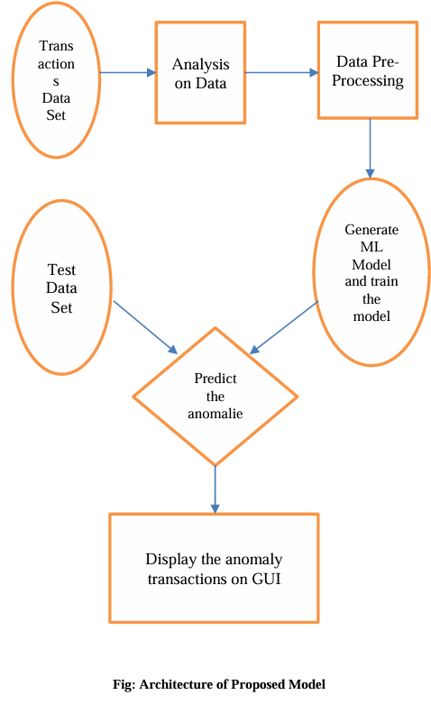
ARCHITECTURE
Department of Computer Science & Engineering (Data Science) 18

Slide 19
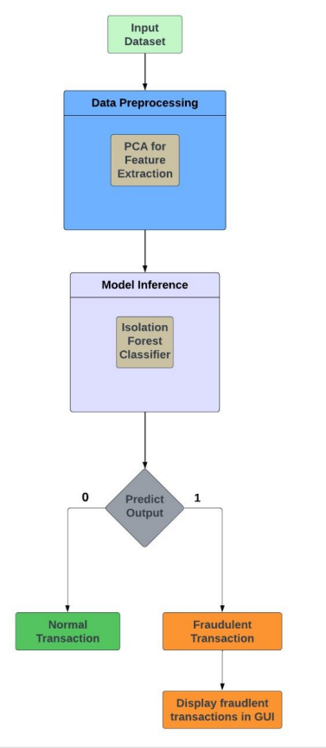
Project Flow
4/27/2024
Department of Engineering
19
Department of Computer Science & Engineering (Data Science) 19

Slide 20
SYSTEM REQUIREMENTS
Software Requirements:
• Operating System: Windows 7/8/10
• Front End: Stream lit Framework
• Scripts: Python Scripts
• Tools: Jupyter Notebook, Visual Studio
Hardware Requirements:
• Processor –I3/Intel Processor
• RAM – 4GB (min)
• Hard Disk – 160GB
• Keyboard – Standard Windows Keyboard
Mouse – Two or Three Button Mouse
Department of Computer Science & Engineering (Data Science) 20

Slide 21
MODULES
Data Preparation
Feature Selection
Isolation Forest Algorithm
Model Training
Anomaly Detection
Threshold Setting
Evaluation
Iterative Refinement
Deployment
Department of Computer Science & Engineering (Data Science) 21

Slide 22
MODULE DESCRIPTION
Data Preparation:
- Load the credit card transaction dataset from the CSV file into memory.
Each row represents a transaction, and columns may include features such as
transaction amount, time, location, etc.
- Preprocess the data by handling missing values, encoding categorical
variables, and scaling numerical features if necessary.
Feature Selection :
- Select relevant features that might help in identifying anomalies in the
dataset. Features such as transaction amount, time of transaction, merchant ID,
etc., can be useful for detecting anomalies.
Department of Computer Science & Engineering (Data Science) 22

Slide 23
MODULE DESCRIPTION
Isolation Forest Algorithm :
- Apply the Isolation Forest algorithm to the pre-processed dataset. The
algorithm works by randomly selecting a feature and then randomly selecting a
split value between the maximum and minimum values of the selected feature.
This process is repeated recursively to isolate anomalies efficiently.
- Anomalies (outliers) are identified as instances that require fewer splits to
isolate, meaning they are different from the majority of the data points.
Model Training :
- Train the Isolation Forest model on the prepared dataset. This involves using
the transaction data to build the isolation trees, which are binary trees where
each internal node represents a split on a feature, and each leaf node represents
an outlier or an inlier.
Department of Computer Science & Engineering (Data Science) 23

Slide 24
MODULE DESCRIPTION
Anomaly Detection :
- Once the model is trained, apply it to the same dataset to identify anomalies.
Anomalies are instances that have shorter average path lengths in the isolation
trees, indicating that they are easier to isolate and hence considered outliers.
Threshold Setting :
- Determine a threshold for anomaly scores based on the characteristics of the
dataset and the desired level of sensitivity to anomalies.
Instances with anomaly scores above this threshold are flagged as potential fraudulent transactions.
Department of Computer Science & Engineering (Data Science) 24

Slide 25
MODULE DESCRIPTION
Evaluation :
- Evaluate the performance of the Isolation Forest algorithm on the dataset.
This can be done using metrics such as precision, recall, F1-score, or ROC
AUC depending on the specific requirements of the application.
Iterative Refinement :
- Refine the model iteratively by adjusting parameters, feature selection, or
preprocessing techniques to improve anomaly detection performance.
Department of Computer Science & Engineering (Data Science) 25

Slide 26
MODULE DESCRIPTION
Deployment :
- Once satisfied with the performance, deploy the trained Isolation Forest
model for real-time or batch processing of credit card transactions to detect
anomalies and potentially fraudulent activities.
Conclusion :
By following these steps, you can effectively apply the Isolation Forest
algorithm to a dataset of credit card transactions to detect anomalies and
identify potentially fraudulent activities.
Department of Computer Science & Engineering (Data Science) 26

Slide 27
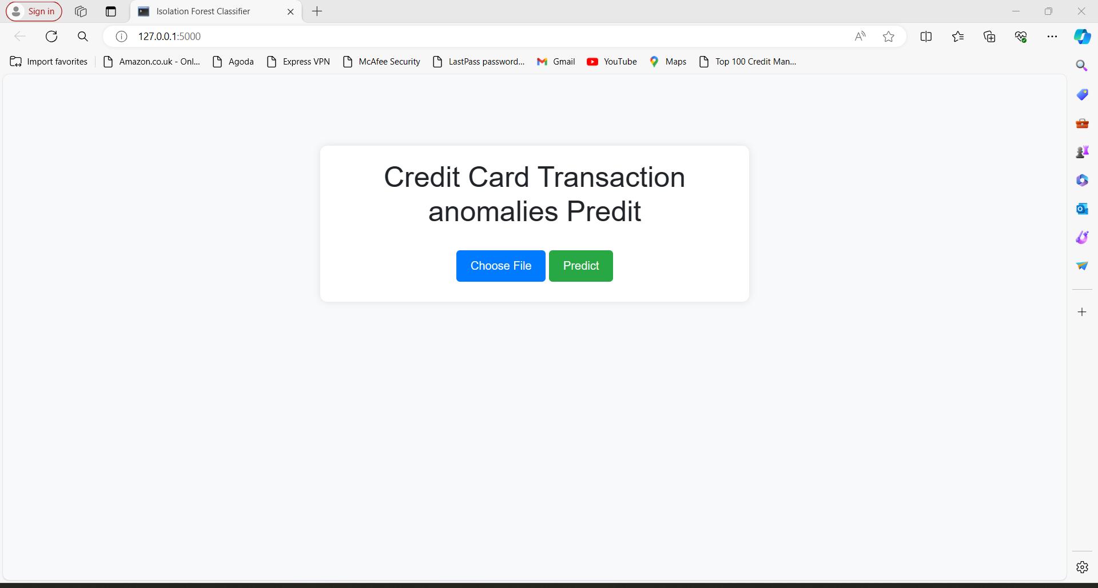
RESULTS
4/27/2024
Department of Computer Science & Engineering
27
Department of Computer Science & Engineering (Data Science) 27

Slide 28
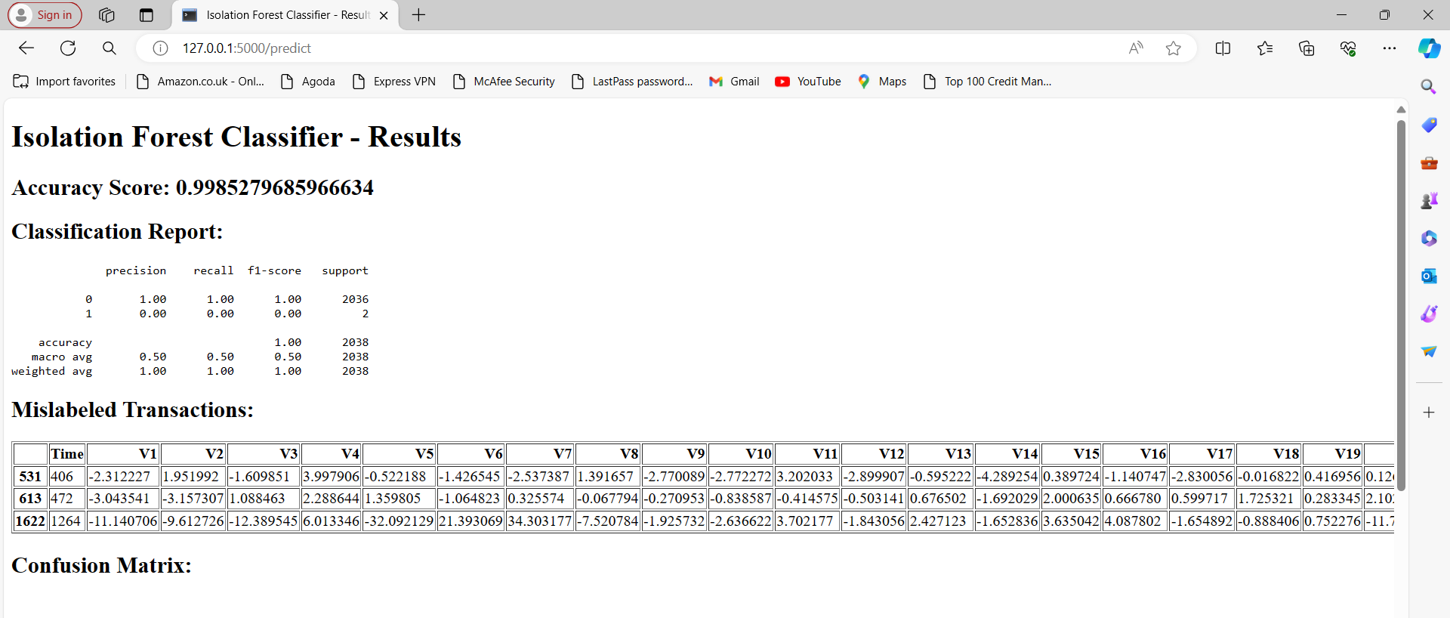
RESULTS
4/27/2024
Department of Computer Science & Engineering
28
Department of Computer Science & Engineering (Data Science) 28

Slide 29
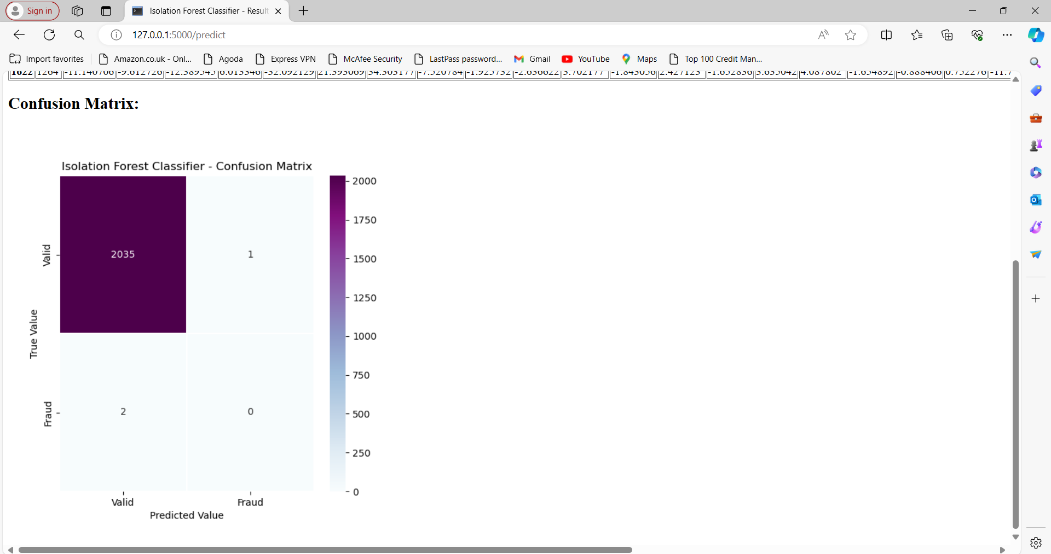
RESULTS
4/27/2024
4/27/2024
Department of Computer Science & Engineering
Department of Computer Science & Engineering
29
29
Department of Computer Science & Engineering (Data Science) 29

Slide 30
Thank You

